Slide 1
Loan Approval Prediction
Caitriona O’Donohoe

Slide 2

The Problem
~51% of Americans have taken out a personal loan in their lifetime
Manually processing loan applications costs banks in labor costs
Can we predict loan application approval based on key applicant features, streamlining the application process for loan institutions?

Slide 3

What factors may affect loan approval?
Credit History
Education
Marital Status
Income
Loan Amount
Applicant Gender
Number of Dependents
Whether applicant is self-employed

Slide 4
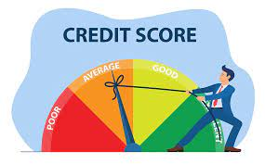
Data Information
Sourced from Kaggle, acquired November 2023
Originally 614 rows, depicting 12 features
Features:
Gender, Marital Status, Dependents, Education, Self-Employment, Applicant Income, Co-Applicant Income, Loan Amount, Term, Credit History, Area, & Status of Loan

Slide 5
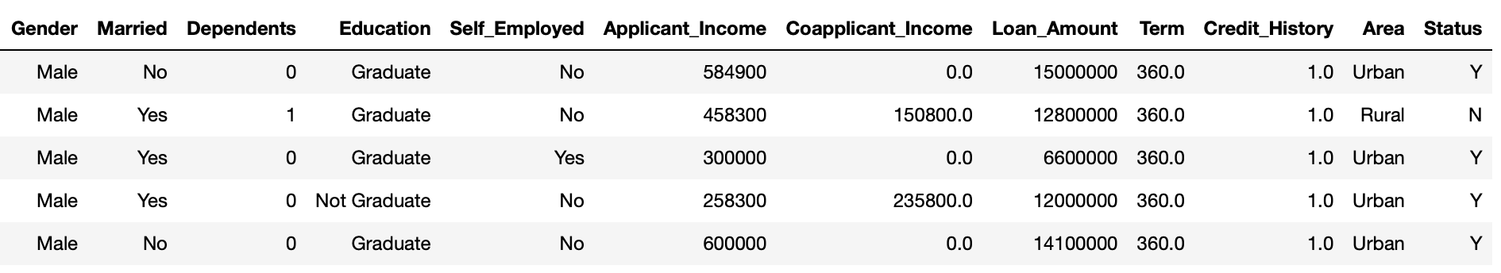
Data Wrangling
All categorical values converted to numerical
Label Encoder
New column created: Total Income (Applicant Income + Co-Applicant Income)
Missing values filled using mode
Luckily, relatively few missing values

Slide 6
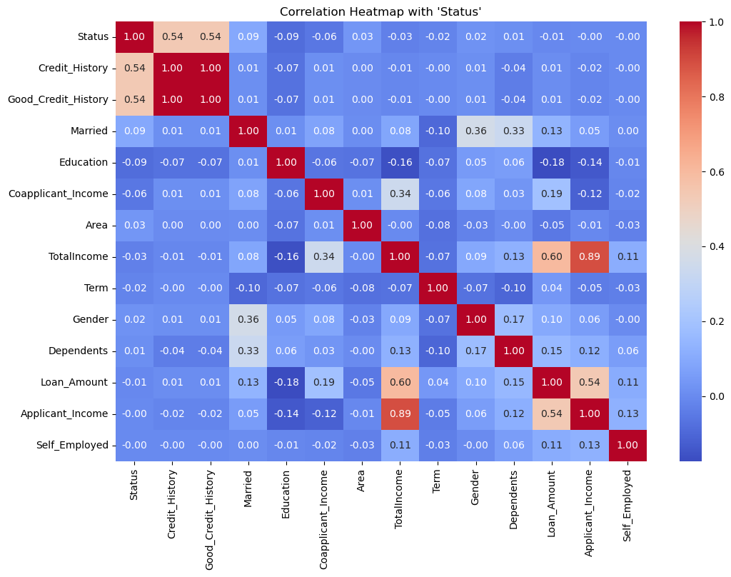
Exploratory Data Analysis
Target feature: Status
Strongest Correlation: Credit History
Manual feature engineering: creation of ‘Good_Credit_History’ column
Other notable features: Marital status, Education, and Income

Slide 7
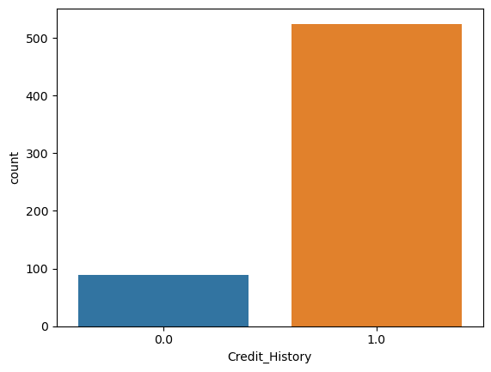
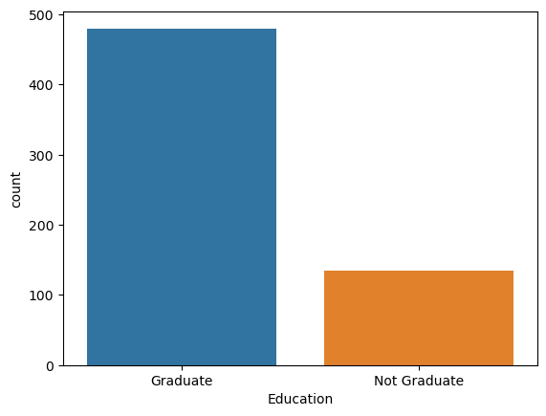
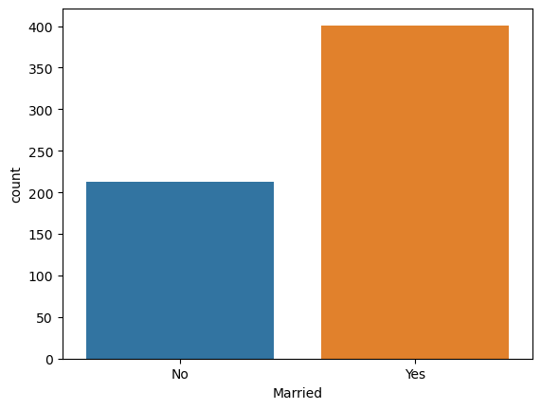
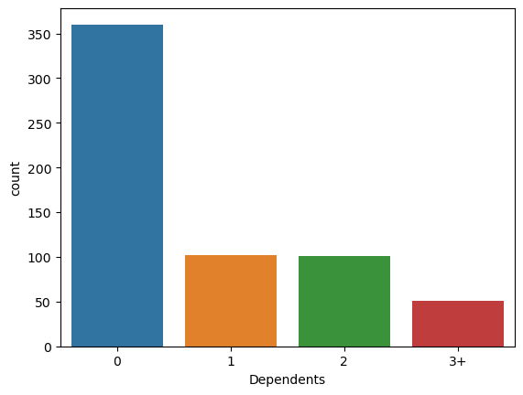
Exploratory Data Analysis (cont.)

Slide 8
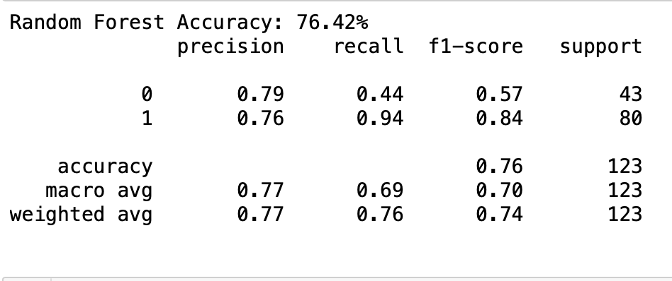
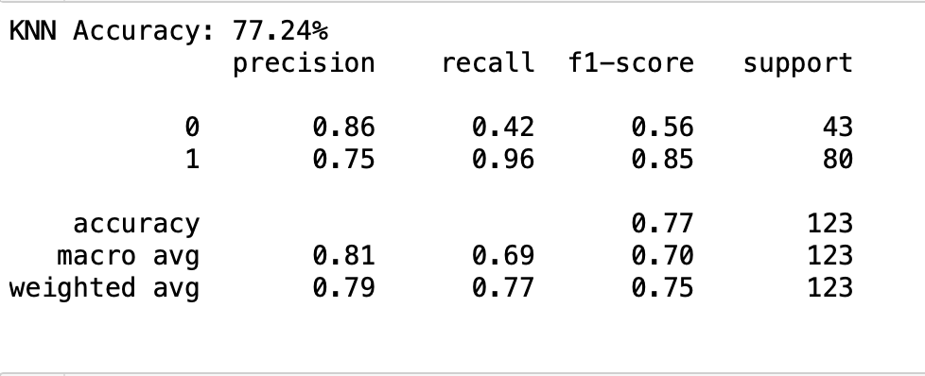
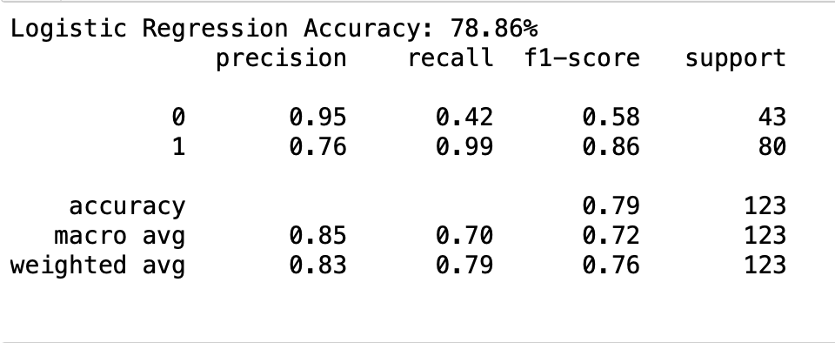
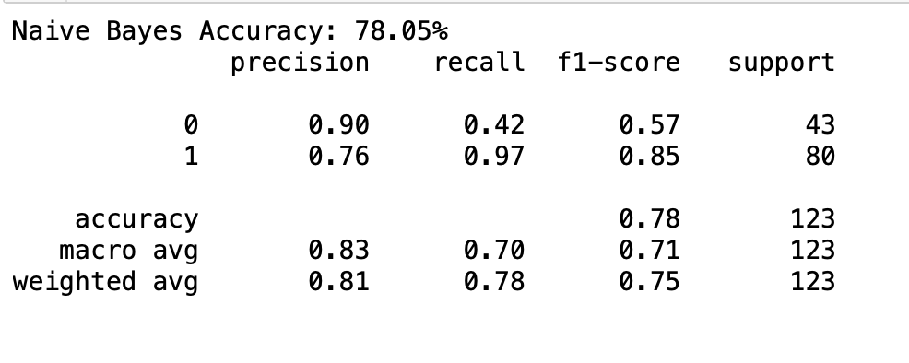
Modelling
Best performing model: Logistic Regression Model

Slide 9
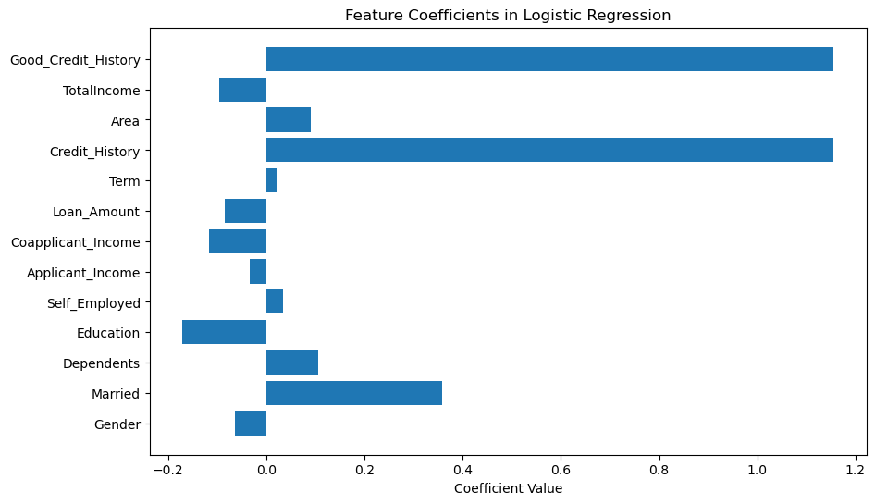
Final Model
Logistic Regression Model
Accuracy 78.86%
Grid Search CV, best C = 0.1
Coefficients assigned to each feature →

Slide 10

Takeaways & Impact
Most influential feature: Credit history
Business benefits of data-driven automated approval system
Reduces labor-costs
Streamlines application process
Reduces risk for loan institutions
Societal/Economic Benefits
Reduces risk of discriminatory practices
Promotes fair lending practices
Reduces risk of bad loans, which contribute to economic crisis

Slide 11
Thank you for listening!
—
Any Questions?
Jupyter notebook & detailed report available here

